Slide 2


Breaking Down Modern Web Page Rendering Strategies
Notes:
Hello Everyone, Are you curious about the different page rendering techniques used in modern web development? Do you want to learn more about how CSR, SSR, SSG, and ISR can impact website performance and user experience? If so, you’re in the right place! In today's tech session, we'll be exploring each rendering technique, and we'll be discussing some real-world use cases to help you understand when and how to use each approach. By the end of this session, you'll have a better understanding of the trade-offs associated with each technique, and you'll be able to make more informed decisions about which rendering approach to use in your next web development project.

Slide 3
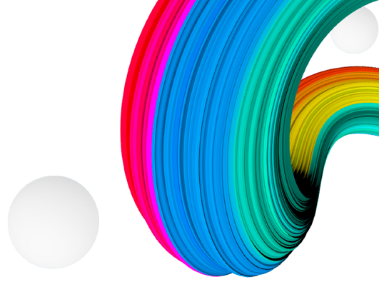

Agenda
1 | Exploring Various Page Rendering Techniques
2 | Deep-Dive into ISG/ISR Architecture
3 | Real-World Use Cases and Challenges
4 | Q&A
 | Latest status of QE Accelerators
Notes:
In the next 45 minutes, we will delve into the following agenda items for today's tech discussion, reserving the final portion for Q&A.

Slide 4
Exploring Various Page Rendering Techniques
Notes:
Let’s Exploring Various Page Rendering Techniques

Slide 5








data
template
Client-Side Rendering
Server-Side Rendering
Static-Site Generation
Notes:
CSR – Let’s see Client-Side Rendering the most popular web page generation architecture where the browser renders the page content by executing JavaScript code. The server sends an empty HTML page, and the JavaScript code runs on the client-side to fetch data from the server and dynamically generate the page. CSR is popular for its interactivity, as it allows developers to create highly responsive web applications. However, it can impact SEO, as search engines have difficulty indexing dynamically generated content. If SEO is a significant aspect of your application, let's explore other options available, such as Server-side Rendering (SSR).
SSR is an architecture for generating pages where the server creates the HTML for the page and sends it to the browser. In contrast to Client-side Rendering (CSR), the browser receives a fully formed HTML page containing the page content, with JavaScript being utilized solely for enhancing interactivity. This characteristic of SSR is advantageous for SEO since search engines can easily index the page content. However, SSR may have slower loading times compared to CSR because the server needs to generate the page for each request. This can be improved by implementing effective caching strategies. Consequently, the Time to First Byte metric will be higher than on a statically generated page.
Wait, can we not generate static page using SSR. Yes we can but it happens on each user requests.
Now, what if we could generate pages well in advance, even before the user makes a request? This brings us to another level in the realm of page rendering strategies.
SSG – Static Site Generation is a web page generation architecture where the server generates the HTML for the page at build time and sends it to the browser. SSG outperforms SSR in terms of speed because the server only generates the page once during the build process, and the resulting HTML is cached and served for every request. SSG is ideal for sites with static content that does not require frequent updates. Static content is fast, resilient to downtime, and immediately indexed by crawlers.
However, SSG can have limitations when it comes to creating highly dynamic web applications.
For better understanding, let’s see one of the use cases.

Slide 6
data
template
Client-Side Rendering
Server-Side Rendering
Static-Site Generation
Notes:
CSR – Let’s see Client-Side Rendering the most popular web page generation architecture where the browser renders the page content by executing JavaScript code. The server sends an empty HTML page, and the JavaScript code runs on the client-side to fetch data from the server and dynamically generate the page. CSR is popular for its interactivity, as it allows developers to create highly responsive web applications. However, it can impact SEO, as search engines have difficulty indexing dynamically generated content. If SEO is a significant aspect of your application, let's explore other options available, such as Server-side Rendering (SSR).
SSR is an architecture for generating pages where the server creates the HTML for the page and sends it to the browser. In contrast to Client-side Rendering (CSR), the browser receives a fully formed HTML page containing the page content, with JavaScript being utilized solely for enhancing interactivity. This characteristic of SSR is advantageous for SEO since search engines can easily index the page content. However, SSR may have slower loading times compared to CSR because the server needs to generate the page for each request. This can be improved by implementing effective caching strategies. Consequently, the Time to First Byte metric will be higher than on a statically generated page.
Wait, can we not generate static page using SSR. Yes we can but it happens on each user requests.
Now, what if we could generate pages well in advance, even before the user makes a request? This brings us to another level in the realm of page rendering strategies.
SSG – Static Site Generation is a web page generation architecture where the server generates the HTML for the page at build time and sends it to the browser. SSG outperforms SSR in terms of speed because the server only generates the page once during the build process, and the resulting HTML is cached and served for every request. SSG is ideal for sites with static content that does not require frequent updates. Static content is fast, resilient to downtime, and immediately indexed by crawlers.
However, SSG can have limitations when it comes to creating dynamic web applications.
let’s see one of the use case for better understanding and how we can leverage these rendering techniques.

Slide 7

Case Study

Slide 8

Use Case
App should have high degree of interactivity with third party library like google map.
The application need to handle and display a larger dataset consisting of more than thousand of pages.
Ensuring that the latest information is available to users.(backend data update on interval of 12 hours)
SEO is a critical aspect of the application, requiring it to be easily crawlable by search engines.
Support localization in multiple languages, including English(en-us), Spanish(es), and French(fr).
Low server cost, optimizing expenses and resource utilization.
Performance of Page (should render first fold less then a second).
Faster build time.
Notes:
Talk briefly about the use case points

Slide 9


Let’s See All Together
Use Cases | CSR | SSR | SSG
App should have high degree of interactivity with third party like google map
Display a larger dataset consisting of more than thousand of pages.
Ensuring that the latest information is available to users
SEO is key part of application. Should be able to crawlable by search engines
Support localization (en-us, es, fr)
Low server cost, optimizing expenses and resource utilization
Performance of Page (should render first fold less then a second)
Faster build time
Tradeoffs or extra development effort involved
Notes:
Ok let see all generation strategies together with these use cases. As we can see here, using CSR, SSR and SSG we can develop application but we not able to achieving the best for application. However, we can achieve but need extra development efforts or we have to live with some of trade-offs.
But what is the solution? Do we have any way by which we can leverage the benefit of SSR and SSG?

Slide 10

DO WE HAVE BETTER APPROACH?

Slide 11



Incremental Static Regeneration - ISR
Build Faster
Cache More Pages
ISR is a web page generation architecture that combines the benefits of SSG and SSR.
ISR generates the HTML for the page at build time, but also allows to create or update specific pages after you’ve built your site.
Notes:
ISR is a web page generation architecture that combines the benefits of SSG and SSR.
ISR generates the HTML for the page at build time, but also allows to create or update specific pages after you’ve built your site.
This way we can have faster build time

Slide 12



How ISR Works?
Build Step - Generate Page
Serve from Cache
revalidate: 60
Post Build
Create/Update Pages
Update Cache
Notes:
When to use ISG/ISR?
1. SEO Optimization: If application heavily relies on search engine optimization.
2. Dynamic Data Revalidation: Need to revalidate the data of generated pages either on a time-based schedule or on-demand
3. Performance and Scalability: Can significantly enhance the performance and scalability of your application by serving pre-rendered static content to users. This reduces the need for server-side processing during each request, resulting in faster page load times and improved overall user experience.

Slide 13



How to Re-Generate/Revalidate Pages Post Build?
Time-Based Revalidation
On-Demand Revalidation
Notes:
Time-Based Revalidation:
Scheduled Interval: Set up a cron job or a similar scheduling mechanism to trigger the regeneration of ISR pages at specific intervals. For example, you can schedule a regeneration process to run every hour, every day, or based on your application's specific needs.
Time-to-Live (TTL): Assign a time-to-live value to each ISR page, indicating how long the generated page remains valid before it needs to be regenerated. Once the TTL expires, the page is revalidated and regenerated. This approach ensures that pages are updated periodically based on their time-to-live duration.
On-Demand Revalidation:
User Triggered: Implement a user interface or an API endpoint that allows users or administrators to trigger the revalidation and regeneration of specific ISR pages. This can be useful when immediate updates are required, such as when a user submits new data or makes changes that need to be reflected on the page instantly.
Event-Based: Integrate event-driven mechanisms in your application to automatically trigger ISR page regeneration when specific events occur. For example, when new data is added or modified in the underlying data source, an event can be triggered to initiate the revalidation process.

Slide 14
Let’s See All Together
Use Cases | CSR | SSR | SSG | ISR
App should have high degree of interactivity with third party like google map
Display a larger dataset consisting of more than thousand of pages.
Ensuring that the latest information is available to users
SEO is key part of application. Should be able to crawlable by search engines
Support localization (en-us, es, fr)
Low server cost, optimizing expenses and resource utilization
Performance of Page (should render first fold less then a second)
Faster build time
Tradeoffs or extra development effort involved
Notes:
In conclusion, choosing the right web page generation architecture depends on the specific needs of your website or application. If interactivity is a priority, CSR may be the best choice. If SEO is a priority, SSR or ISR may be the best choice. If speed and caching are a priority, SSG or ISR may be the best choice. Ultimately, it's important to consider the trade-offs of each approach and choose the one that best fits your specific needs.
Make clear point if we can implement google map

Slide 15
Challenges with ISR

Slide 16

Incremental Static Regeneration (ISR) offers benefits such as improved performance and allow update page after build. However, it also presents some challenges.
Challenges with ISR Rendering Techniques(Self Experience)
Data Inconsistency on Regenerated Pages
Build Once, Deploy Anywhere not Possible
Sync Pages Revalidation Time with Backend
Notes:
1. Data inconsistency with multiple pods.
2. Build Once, Deploy Many
3. Sync Revalidate Time of Pages with Backend – If backend service getting refreshed every day at same time and we want to regenerate pages and update their info at same time is a challenge with ISR. In ISR pages getting generated when user request for the page. So, revalidate time will be different for different pages.

Slide 17
Data Inconsistency on Regenerated Pages
Load Balancer
Create/Update
Pages on each pod
revalidate: 60s
V1
V2
V3
revalidate: 60s
Pod 1
Pod 2
Pod 3
Notes:
Data consistency can pose a challenge with ISR due to the dynamic nature of data updates and the regeneration process.

Slide 18
Data Inconsistency on Regenerated Pages
CDN Layer
Load Balancer
Create/Update
Pages on each pod
revalidate: 60s
V1
V2
V3
revalidate: 60s
Pod 1
Pod 2
Pod 3

Slide 19
Data Inconsistency on Regenerated Pages
CDN Layer
Load Balancer
Create/Update
Pages on shared volume
V1
V2
V3
Pod 1
Pod 2
Pod 3
revalidate: 60s
Shared Volume
Notes:
Data consistency can pose a challenge with ISR due to the dynamic nature of data updates and the regeneration process.

Slide 20


Sync Pages Revalidation Time(TTL) with Backend Db Sync
revalidate: 60 * 60 * 6
Post Build
Create/Update Pages
Update Cache
backend sync scheduled each day at 12am
Notes:
Sync Pages Revalidation Time is tricky and totally depend on what kind of use cases we have.
Here talk about event base revalidation, cron job for daily build of app, CMS if someone update page trigger revalidate particular page.

Slide 21
Sync Pages Revalidation Time(TTL) with Backend Db Sync
revalidate: 60 * 60 * 6
Post Build
Create/Update Pages
Update Cache
backend sync scheduled each day at 12am
Notes:
Sync Pages Revalidation Time is tricky and totally depend on what kind of use cases we have.
Here talk about event base revalidation, cron job for daily build of app, CMS if someone update page trigger revalidate particular page.

Slide 22
Sync Pages Revalidation Time(TTL) with Backend Db Sync
revalidate: 60 * 60 * 6
Post Build
Create/Update Pages
Update Cache
backend sync scheduled each day at 12am
Notes:
Sync Pages Revalidation Time is tricky and totally depend on what kind of use cases we have.
Here talk about event base revalidation, cron job for daily build of app, CMS if someone update page trigger revalidate particular page.

Slide 23
Sync Pages Revalidation Time(TTL) with Backend Db Sync
revalidate: 60 * 60 * 6
Post Build
Create/Update Pages
Update Cache
backend sync scheduled each day at 12am
Notes:
Sync Pages Revalidation Time is tricky and totally depend on what kind of use cases we have.
Here talk about event base revalidation, cron job for daily build of app, CMS if someone update page trigger revalidate particular page.

Slide 24

Build Once, Deploy Anywhere not Possible
Build Once – Deploy Everywhere
vs
Dev - Build Step
IT - Build Step
UAT - Build Step
Prod - Build Step
DEV
IT
UAT
PROD
DEV
IT
UAT
PROD
Notes:
Configuring a CI/CD pipeline poses a challenge when working with ISR. The best practice is to build the application once and deploy it everywhere. However, with ISR, there is a need to generate pages during the build process and obtain data specific to different environments. As a result, it becomes necessary to have separate build steps for each environment, introducing complexity to the CI/CD pipeline setup.

Slide 25
Demo

Slide 26
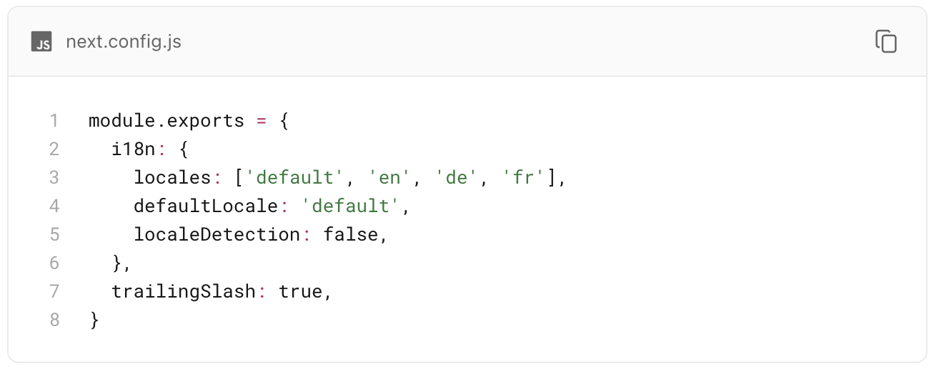
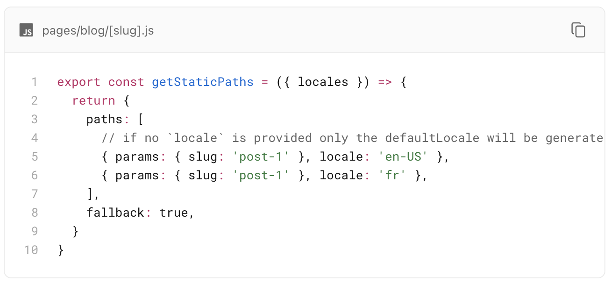
Tips and Tricks
Locale Configuration
Default locale should not be visible on page URL
Configure image with remote path
Redirect Rules
Base Path Configuration

Slide 27
Tips and Tricks
Locale Configuration
Default locale should not be visible on page URL
Configure image with remote path
Redirect Rules
Base Path Configuration

Slide 28
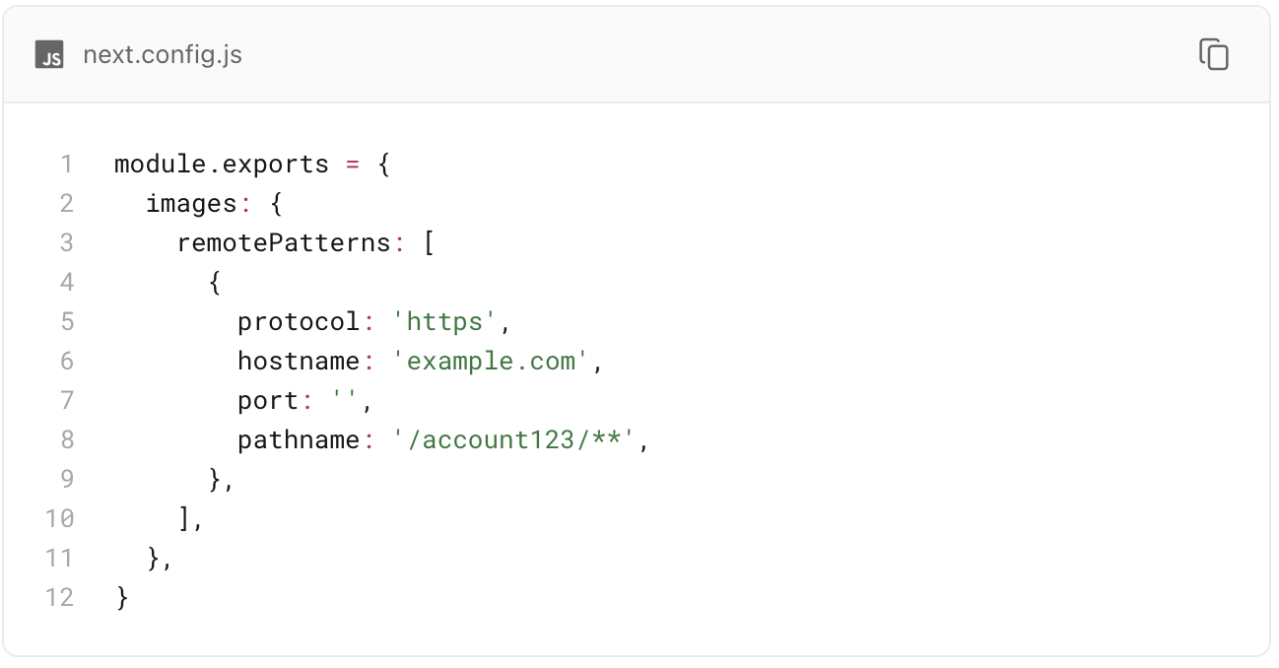
Tips and Tricks
Locale Configuration
Default locale should not be visible on page URL
Configure image with remote path
Redirect Rules
Base Path Configuration

Slide 29
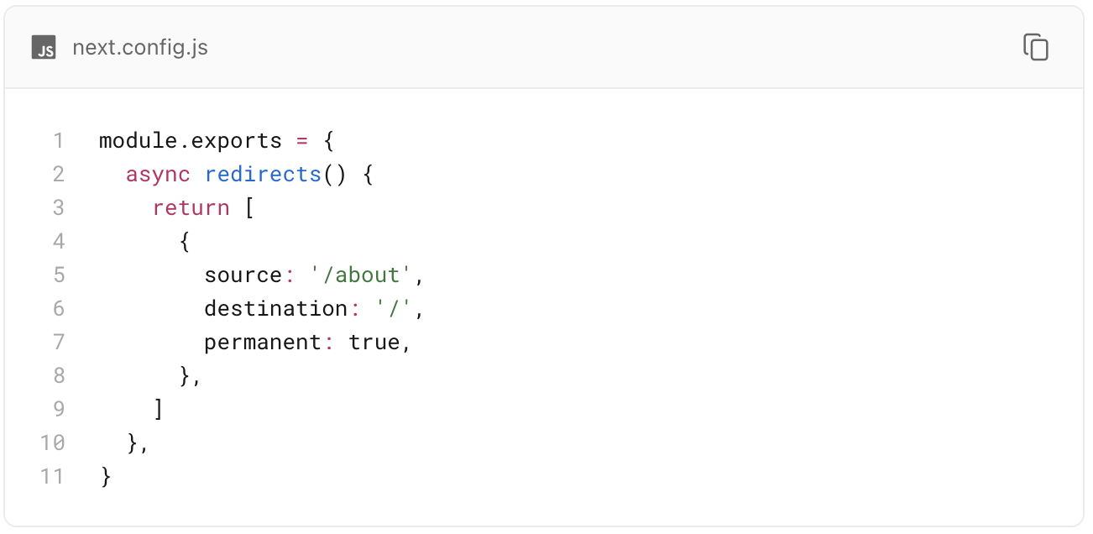
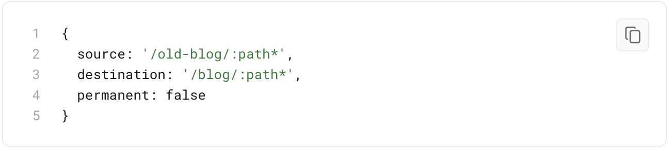
Tips and Tricks
Locale Configuration
Default locale should not be visible on page URL
Configure image with remote path
Redirect Rules
Base Path Configuration

Slide 30
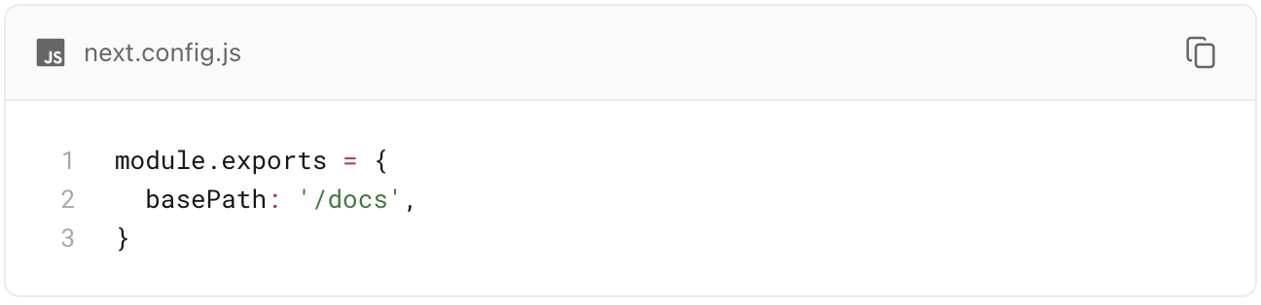
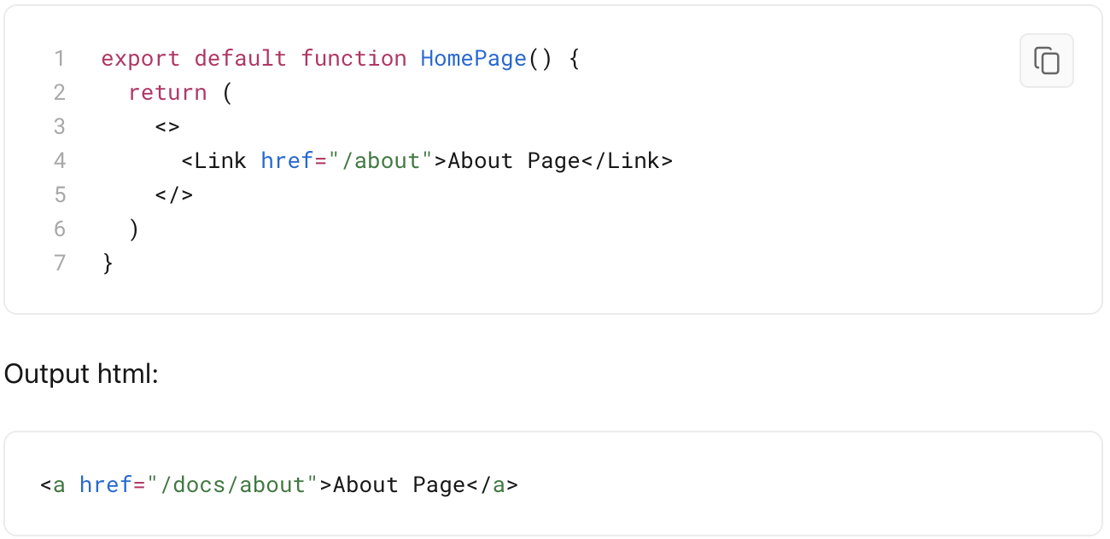
Tips and Tricks
Locale Configuration
Default locale should not be visible on page URL
Configure image with remote path
Redirect Rules
Base Path Configuration

Slide 31
Re-cap

Slide 32
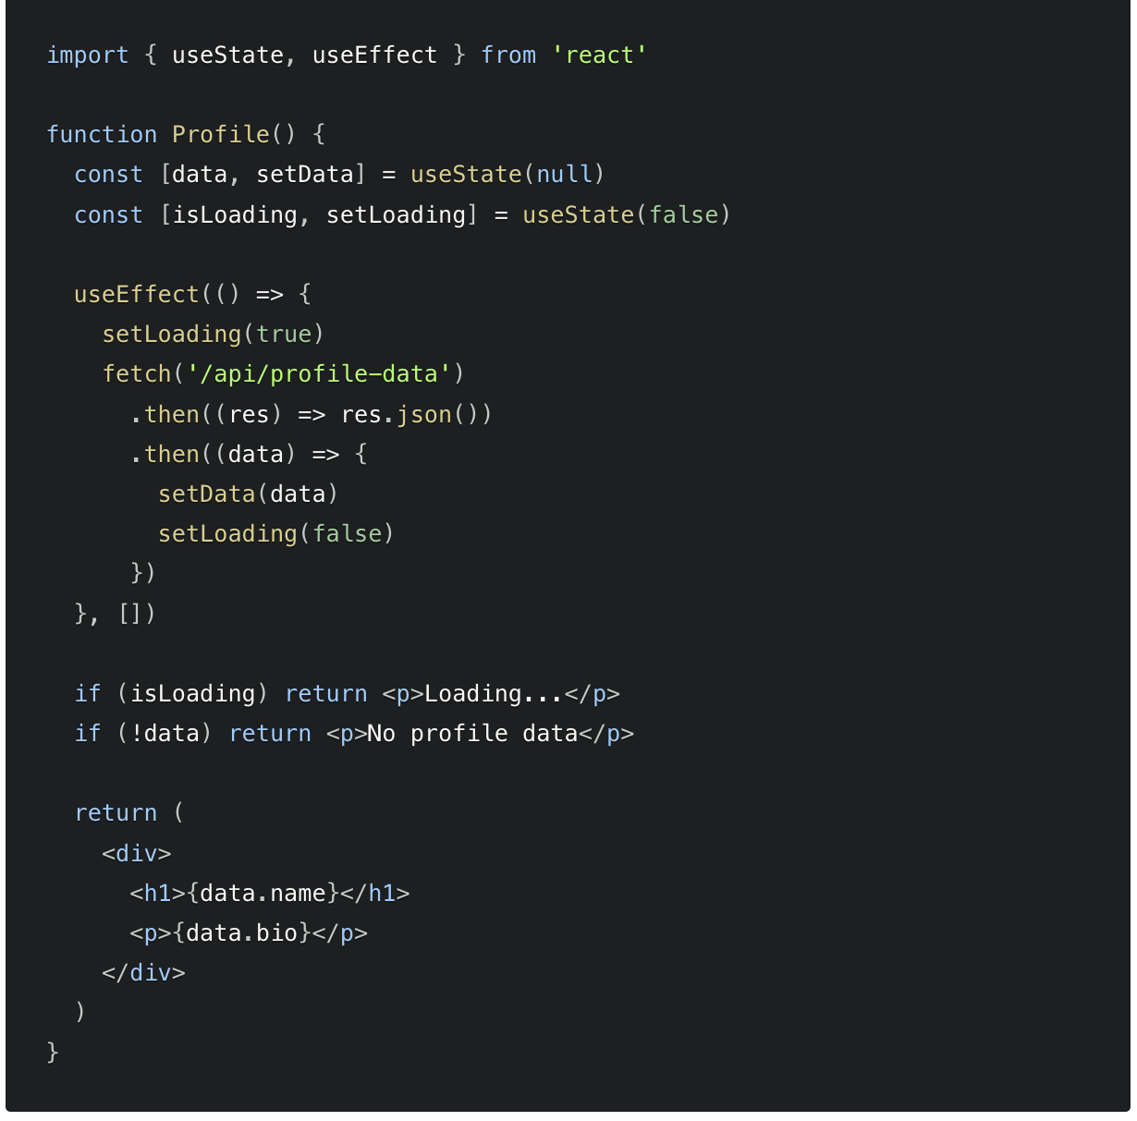
Client-side Rendering and Data Fetching
Client-side data fetching is useful when your page doesn't require SEO indexing, when you don't need to pre-render your data, or when the content of your pages needs to update frequently.
The following example shows how you can fetch data on the client side using the useEffect hook.
It's important to note that using client-side data fetching can affect the performance of your application and the load speed of your pages.
Notes:
Use different slides for csr, ssr,ssg,isr

Slide 33
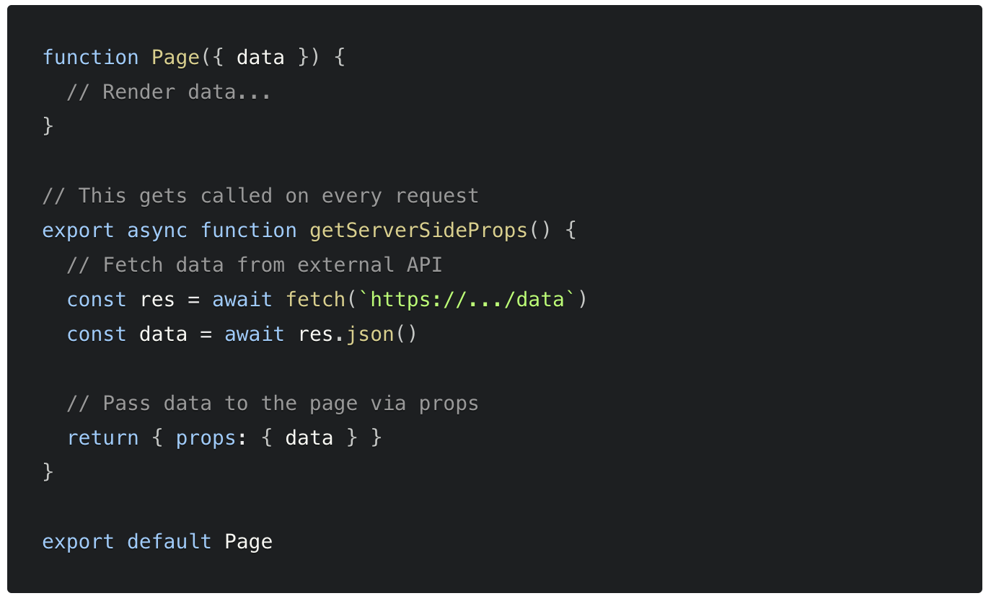
Server-side Rendering and Data Fetching
If you export a function called getServerSideProps (Server-Side Rendering) from a page, Next.js will pre-render this page on each request using the data returned by getServerSideProps.
The following example shows how you can fetch data on the server side using the getServerSideProps hook.
When should I use getServerSideProps
You should use getServerSideProps only if you need to render a page whose data must be fetched at request time and along with SEO is important part of the app
Notes:
Use different slides for csr, ssr,ssg,isr. Different way to achieve SSR apart of NextJS

Slide 34
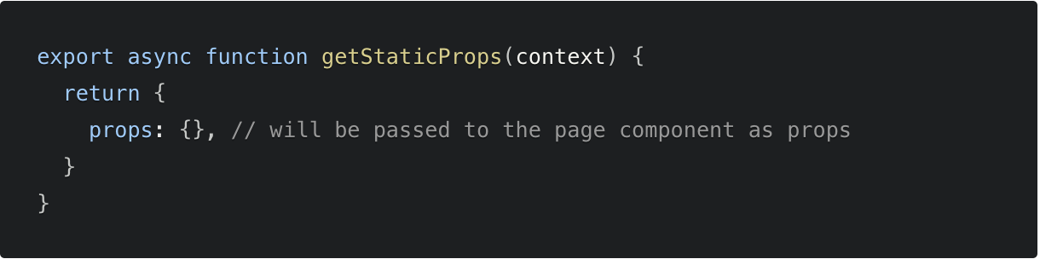
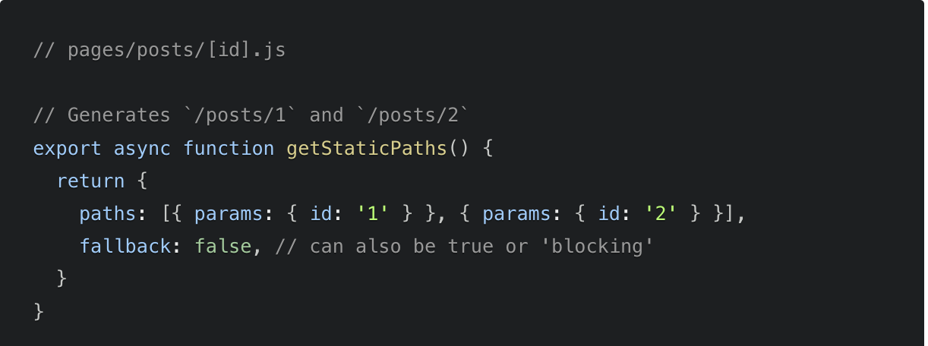
SSG – Static Site Generation
Using SSG allows you to create pages on build time ahead of a user’s request. If a page has Dynamic Routes and uses getStaticProps, it needs to define a list of paths to be statically generated.
When you export a function called getStaticPaths(Static Site Generation) from a page that uses dynamic routes, Next.js will statically pre-render all the paths specified by getStaticPaths.
Notes:
Talk in Numbers how much time spent on average on project setup and all code quality tools setup , pipelines etc
2-3 sprints

Slide 35
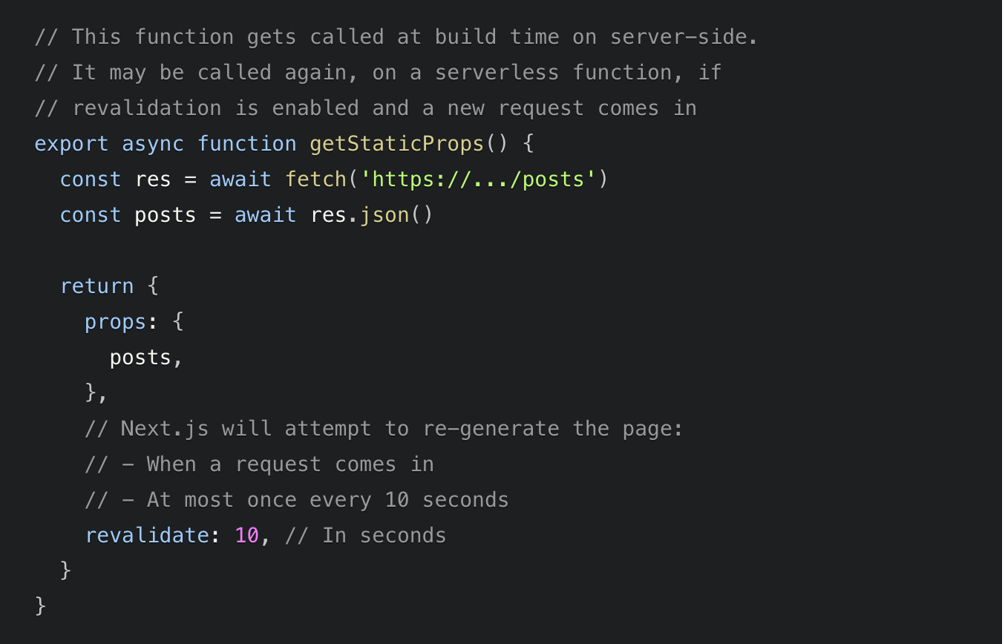
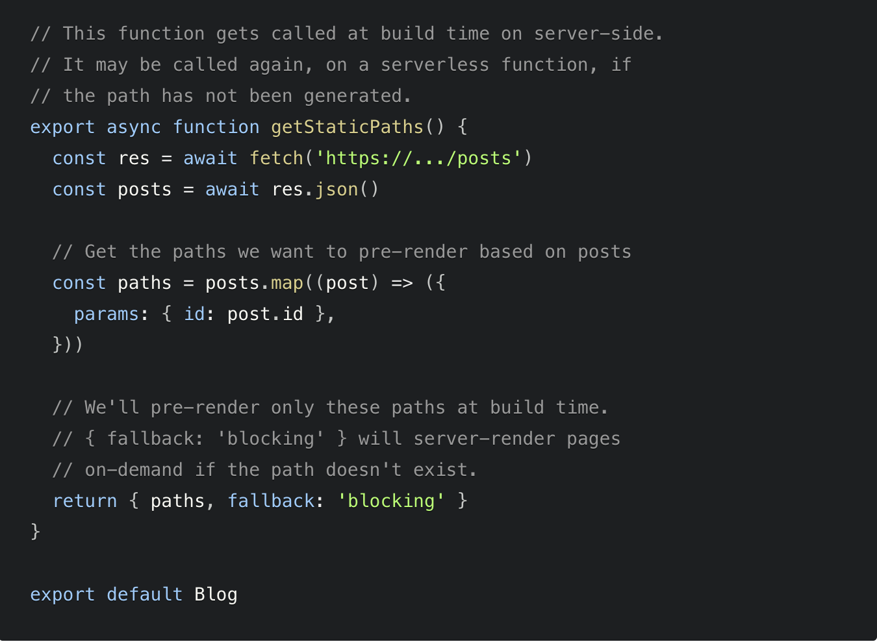
ISG/ISR – Incremental Site Generation/Regeneration
Next.js allows you to create or update static pages after you’ve built your site. Incremental Static Regeneration (ISR) enables you to use static-generation on a per-page basis, without needing to rebuild the entire site. With ISR, you can retain the benefits of static while scaling to millions of pages.
Notes:
These examples are time based revalidation of the pages after build

Slide 36
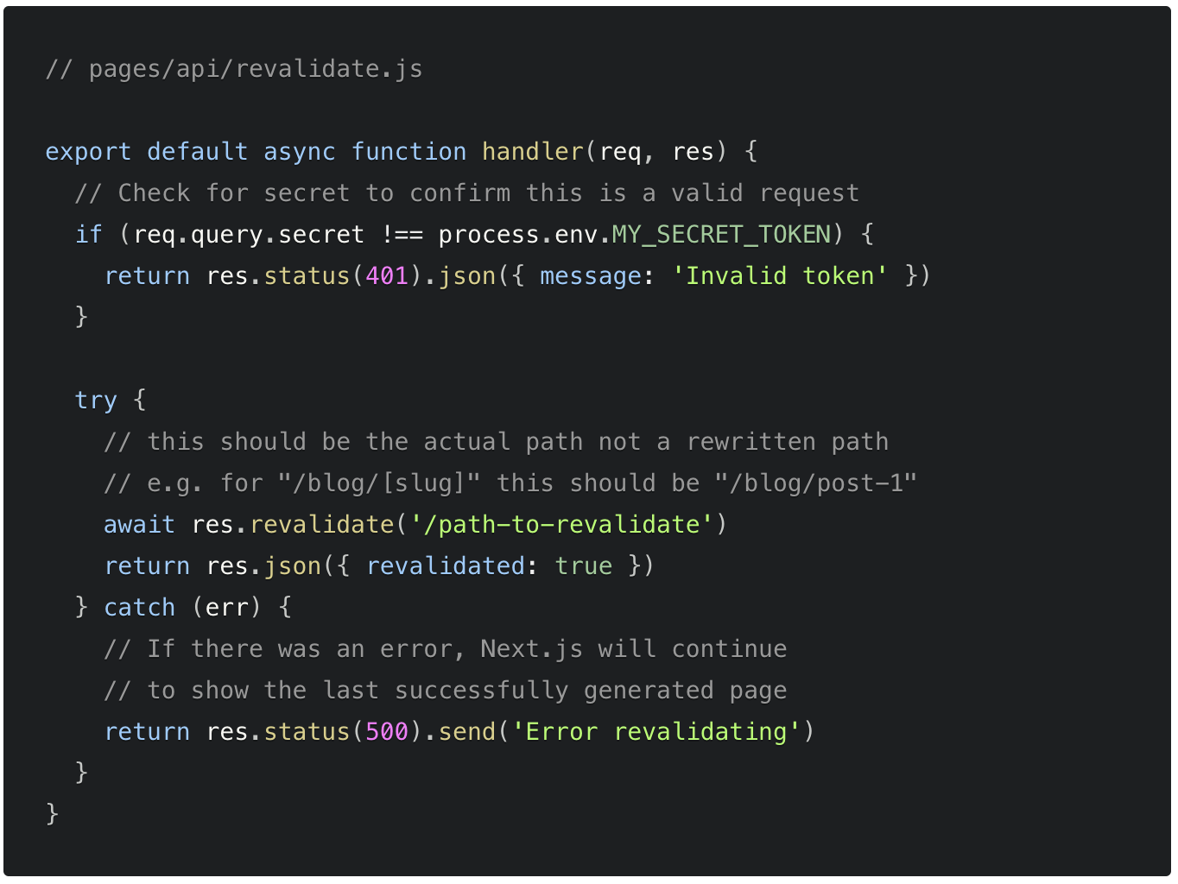
Bonus – On Demand Revalidation
Starting with v12.2.0, Next.js supports On-Demand Incremental Static Regeneration to manually purge the Next.js cache for a specific page. This makes it easier to update your site when:
Content from your headless CMS is created or updated
Ecommerce metadata changes (price, description, category, reviews, etc.)
Notes:
These examples are time based revalidation of the pages after build

Slide 37
Thank You Questions & Feedback

